Slide 1
بسم الله الرحمن الرحیم
Notes:
Introduce yourself
ان شاء الله که وخت خوب و پربرکت خواهیم داشت

Slide 2
JS101 Introduction to Web Programming with Javascript

Slide 3
Welcome
Notes:
Introduce yourself
ان شاء الله که وخت خوب و پربرکت خواهیم داشت

Slide 4
Agenda
Introduction
Course Structure
Algorithms
JavaScript

Slide 5
Introduction
Notes:
Name, education, experience
Ask student to introduce themselves? How many of them have prior programming experience? School or university?

Slide 6
Why JavaScript?

Slide 7





Slide 8










Slide 9
Course Structure
Notes:
teaching: only tells you how to do something
Training: correct your mistakes and guides you through each step.

Slide 10
Outline
Week1: Variables, Conditionals, Functions
Week 2: Loops, Arrays, Strings
Week3: Objects, Error Handling
Week4: DOM and Events
Week5: AJAX
Week6:SPA
Week7: ReactJS Intro
Week8: Thinking in React

Slide 11
Teaching vs Training
Notes:
teaching: only tells you how to do something
Training: correct your mistakes and guides you through each step.

Slide 12
عالم بی عمل – درخت بی ثمر
Notes:
Our teaching philosophy: learn by doing.
چطور در یک شهر نو بلد میشوید.
اول چیز های را یاد بگیر که زیاد سروکار داشته باشی همرایش.
Course suggestion: learning how to learn on Coursera.

Slide 13
what ultimately matters in this course is not so much where you end up relative to your classmates but where
you end up relative to yourself when you began
Notes:
experience that matters is yours
not a competition

Slide 14
Computer Science
Notes:
Introduce yourself
ان شاء الله که وخت خوب و پربرکت خواهیم داشت

Slide 15
input →
Process
→ output
Notes:
Representations: counting on hand, counting with decimal, but computers only have 0s and 1s
Basically computer does 5 basic operations that are input, output, process, storing and controlling.

Slide 16
🖐️

Slide 17
123

Slide 18
1
123

Slide 19
10
1
123

Slide 20
100
10
1
123

Slide 21
100
10
1
123
100 × 1

Slide 22
100
10
1
123
100 × 1
+
10 × 2

Slide 23
100
10
1
123
100 × 1
+
10 × 2
+
1 × 3

Slide 24
100
10
1
123
100
+
20
+
3

Slide 25
123

Slide 26
100
10
1
# # #
Notes:
But why 1, 10, and 100?

Slide 27
10²
10¹
10⁰
# # #

Slide 28
2²
2¹
2⁰
# # #

Slide 29
4
2
1
# # #

Slide 30
4
2
1
000

Slide 31
4
2
1
001

Slide 32
4
2
1
010

Slide 33
4
2
1
011

Slide 34
4
2
1
100

Slide 35
4
2
1
101

Slide 36
4
2
1
110

Slide 37
4
2
1
111

Slide 38
A

Slide 39
65

Slide 40
01000001

Slide 41
ASCII

Slide 42
... | A | B | C | D | E | F | G | H | I | ...
... | 65 | 66 | 67 | 68 | 69 | 70 | 71 | 72 | 73 | ...

Slide 43
72 | 73 | 33

Slide 44
H | I
72 | 73 | 33
Notes:
Call-on

Slide 45
H | I | !
72 | 73 | 33

Slide 46
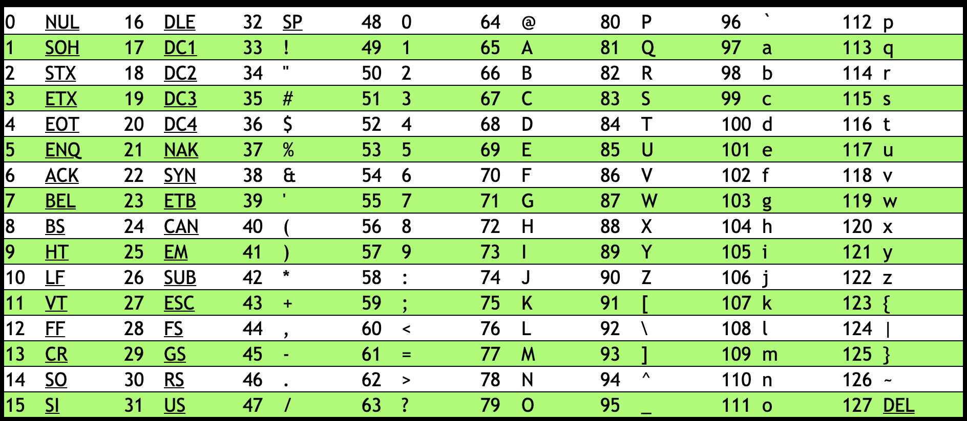
Notes:
https://asciichart.com/

Slide 47
H | I | !
72 | 73 | 33

Slide 48
H | I | !
01001000 | 01001001 | 00100001
Notes:
bytes

Slide 49
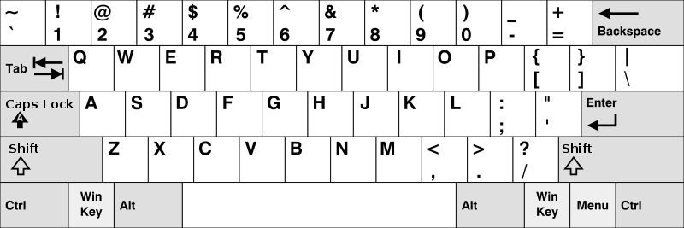
Notes:
https://en.wikipedia.org/wiki/British_and_American_keyboards
But how to represent other symbols?

Slide 50
Unicode

Slide 51
4,036,991,159

Slide 52
11110000 10011111 10011000 10110111

Slide 53

Notes:
https://emojipedia.org/face-with-medical-mask/
Google

Slide 54

Notes:
https://emojipedia.org/face-with-medical-mask/
Apple

Slide 55
Notes:
Should be #484921ff, but brightened for projectors.

Slide 56
RGB

Slide 58
72 | 73 | 33

Slide 59
72 | 73 | 33

Slide 61
Notes:
Should be #484921ff, but brightened for projectors.

Slide 62
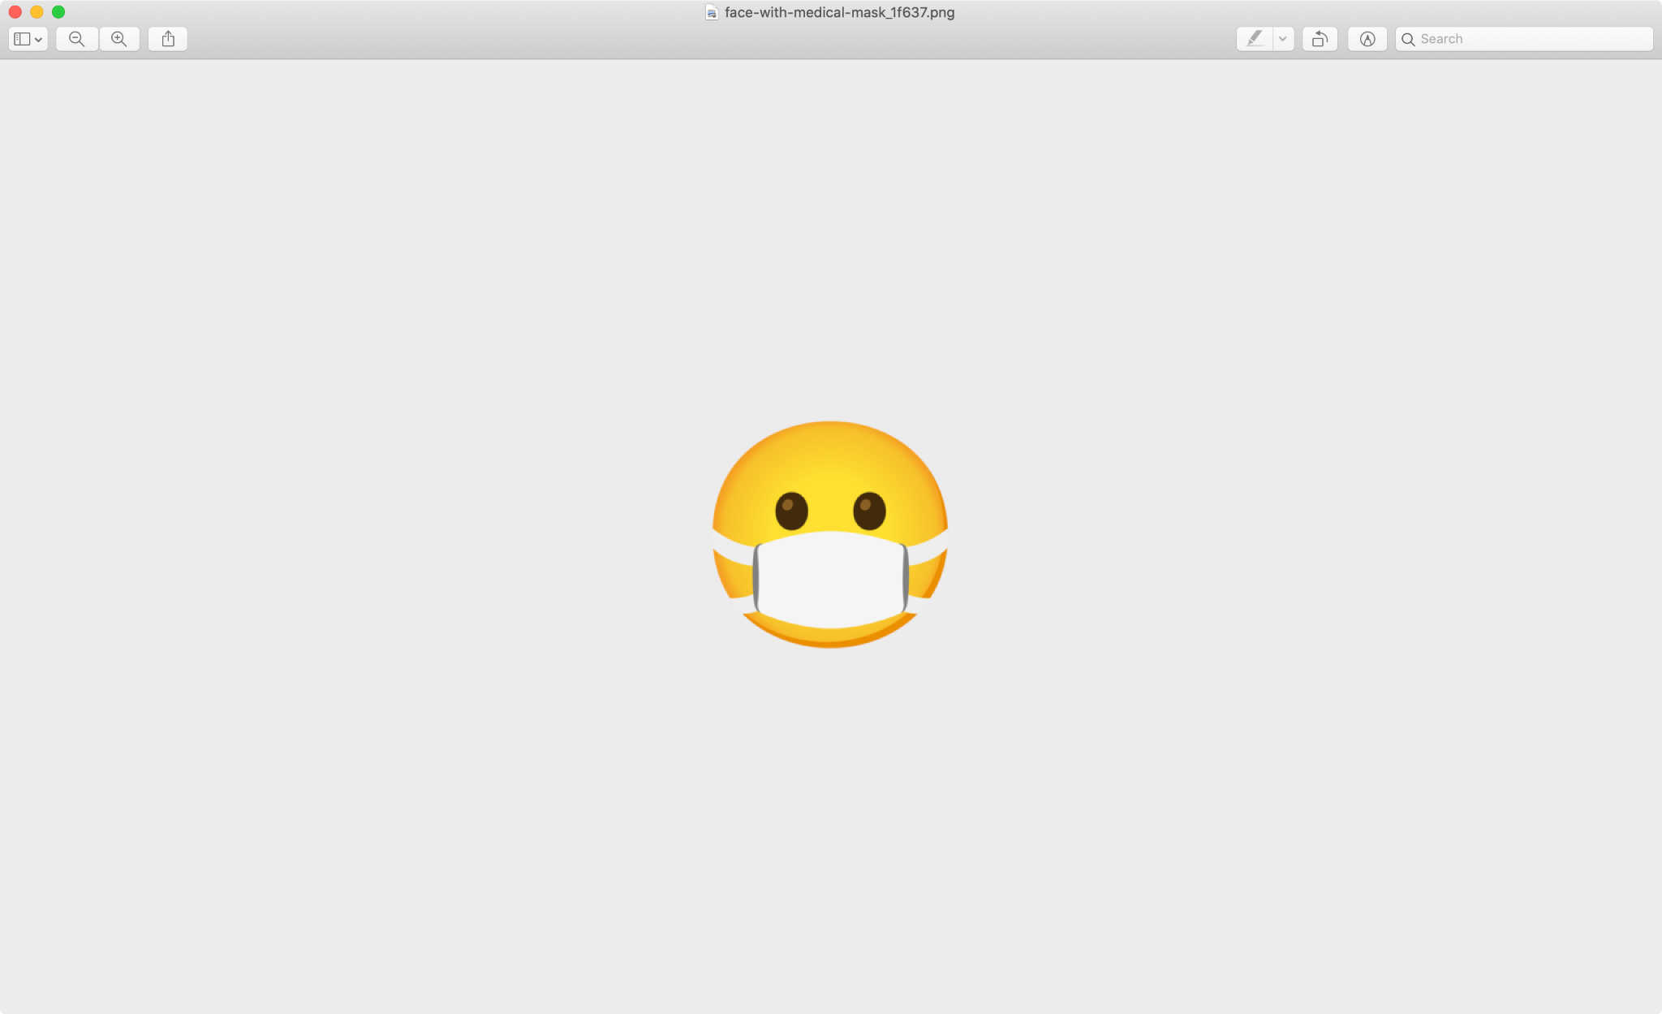

Slide 63


Slide 64


Slide 65
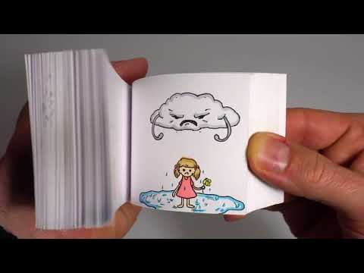
Notes:
https://youtu.be/p3q9MM__h-M

Slide 66
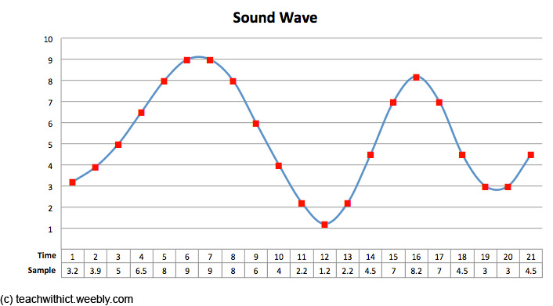
Notes:
note, duration, volume

Slide 67
input →
→ output

Slide 68
algorithm

Slide 69
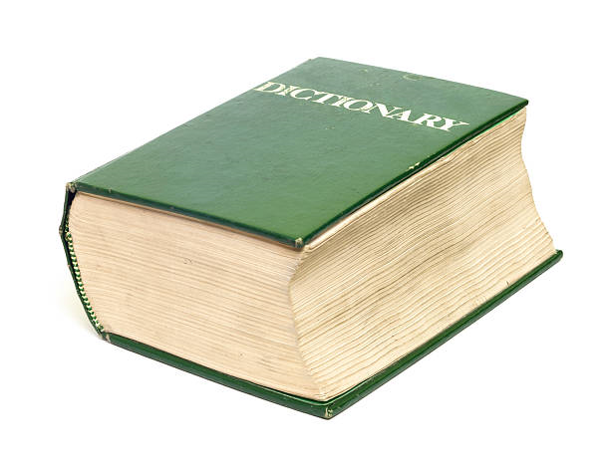
Notes:
https://apps.apple.com/us/app/contacts/id1069512615#?platform=iphone

Slide 70
pseudocode

Slide 71
1 Pick up dictionary
2 Open to middle of dictionary
3 Look at page
4 If word is on page
5 Read the Definition
6 Else if word is earlier in dictionary
7 Open to middle of left half of dictionary
8 Go back to line 3
9 Else if word is later in dictionary
10 Open to middle of right half of dictionary
11 Go back to line 3
12 Else
13 Quit

Slide 72
1 Pick up dictionary
2 Open to middle of dictionary
3 Look at page
4 If word is on page
5 Read the Definition
6 Else if word is earlier in dictionary
7 Open to middle of left half of dictionary
8 Go back to line 3
9 Else if word is later in dictionary
10 Open to middle of right half of dictionary
11 Go back to line 3
12 Else
13 Quit

Slide 73
1 Pick up dictionary
2 Open to middle of dictionary
3 Look at page
4 If word is on page
5 Read the Definition
6 Else if word is earlier in dictionary
7 Open to middle of left half of dictionary
8 Go back to line 3
9 Else if word is later in dictionary
10 Open to middle of right half of dictionary
11 Go back to line 3
12 Else
13 Quit

Slide 74
1 Pick up dictionary
2 Open to middle of dictionary
3 Look at page
4 If word is on page
5 Read the Definition
6 Else if word is earlier in dictionary
7 Open to middle of left half of dictionary
8 Go back to line 3
9 Else if word is later in dictionary
10 Open to middle of right half of dictionary
11 Go back to line 3
12 Else
13 Quit

Slide 75
1 Pick up dictionary
2 Open to middle of dictionary
3 Look at page
4 If word is on page
5 Read the Definition
6 Else if word is earlier in dictionary
7 Open to middle of left half of dictionary
8 Go back to line 3
9 Else if word is later in dictionary
10 Open to middle of right half of dictionary
11 Go back to line 3
12 Else
13 Quit

Slide 76
1 Pick up dictionary
2 Open to middle of dictionary
3 Look at page
4 If word is on page
5 Read the Definition
6 Else if word is earlier in dictionary
7 Open to middle of left half of dictionary
8 Go back to line 3
9 Else if word is later in dictionary
10 Open to middle of right half of dictionary
11 Go back to line 3
12 Else
13 Quit

Slide 77
functions
arguments, return values
conditionals
Boolean expressions
loops
variables
...

Slide 78
Let dictionary;

Slide 79
function pickup()
{
}

Slide 80
if()
{
}
else
{
}

Slide 81
While()
{
}

